Slide 1
Activity #4
Project & Profile Page
Design & Implementation
April 07, 2022

Slide 2
Team Pointers
Team Members :
Aysha
Behroze
Priya
Sara
April 07, 2022

Slide 3
Problem Definition
Redesigning the project and profile page of RCE sask website to make it more attractive.
Search Options With Different Search Area Such As Location And Goals
Different features based on high fidelity (project detail page, add to favorite, filter search, global search, web forms)
Engaging More People/ Viewers into Activities And Project
3

Slide 4
Northstar & Carryover customer:
Northstar customers :
Environmentalist
Researchers
Volunteers (Teachers, students, activists)
Carryover customers:
Stakeholders
All actors( new students, new teachers etc.)
4

Slide 5
WordPress configuration:
Theme : Twenty Twenty
Plugins:
Elementor: Website builder
5

Slide 6

2. WooCommerce
For content management

Slide 7
3. Themify - WooCommerce Product Filter
Product search by applying filters

Slide 8
4. Smart WooCommerce Search
Allows instant products search

Slide 9
5. Formidable Forms
Allows instant products search

Slide 10
6. Popup builder
Allows instant products search

Slide 11
7. Essential Addons for Elementor
- Extended functionality of the basic page builder with creative elements and widgets

Slide 12
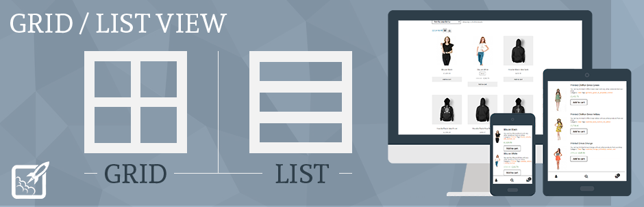
8. NC Grid List View for WooCommerce
For grid/list view
Paid but nice:
WooCommerce grid/list view by berocket
Product listing page with list & grid view

Slide 13
9. YITH WooCommerce Wishlist
For wishlist option and add to favourites

Slide 14
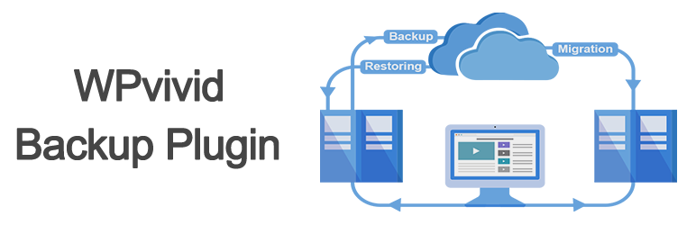
10. WPvivid backup
For back up and restore
Other is UpdraftPlus

Slide 15
Others
These are the plugins we can use in future:
Quick view for wooCommerce
Quickwish
YITH woocommerce share

Slide 16
Minimum viable product #4
WordPress Demo

Slide 17
Thank you

Slide 18
References:
https://envothemes.com/docs/docs/envo-shop/woocommerce/yith-woocommerce-wishlist/
https://en-ca.wordpress.org/plugins/gridlist-view-for-woocommerce/
https://wordpress.org/plugins/wpvivid-backuprestore/
https://wpdeveloper.com/most-popular-elementor-addons/
https://wordpress.org/plugins/popup-builder/
https://formidableforms.com/features/summary-review-before-submit/
https://guaven.com/our-products/woo-search-box/
https://wordpress.org/plugins/woo-product-filter/
https://wordpress.org/plugins/tags/woocommerce/

Slide 19
Q & A

